Slide 1
Tips for Networking Online
Stacy A. Sacco, MBA
sasacco@aol.com
(505) 489-2311
Networking Connections:
LinkedIn (6,151 Followers, 5,469 Connections) https://www.linkedin.com/in/stacysacco/
Facebook (1,578 Friends): https://www.facebook.com/stacy.sacco.31/
Host, New Mexico Networking Links (4,510 Contacts, 40% Open Rate), https://www.nmnetlinks.com/
Employment:
Lecturer, Entrepreneurial Studies, UNM Anderson School of Management, https://www.mgt.unm.edu/
Director, UNM Small Business Institute, https://sbi.mgt.unm.edu/
President, Sacco Connections LLC
Mentor, UNM Rainforest Innovations and UNM Taos, http://loborainforest.com/
Community Service:
Advisory Board Member, Workforce Connections of Central New Mexico, http://www.wccnm.org
Board of Governors, Up With People International Alumni Association, https://upwithpeople.org/alumni/
Host, ABQ Sales and Business Development Professionals Meetup Group (218 Members)
https://www.meetup.com/ABQ-Sales-and-Business-Development-Professionals/
Accolades:
Power Broker (one of the 100 most influential people statewide), New Mexico Business Weekly, 2008-2012
Best Local to Lunch With (1 of 5, ranked #1 in 2014), Albuquerque the Magazine; 2013-2018
Most Connected Businessperson in Albuquerque (1 of 7), Albuquerque Business First, 2015
Best Person to Pitch Albuquerque in an Elevator Speech (1 of 18), Albuquerque Business Pulse Survey, 2015

Slide 2
Why Networking?
Get a Job:
Learn about job openings
Meet prospective employers
Connect with influencers, decision makers, etc.
Start and Grow a Business:
Connect to prospective customers and clients
Connect to resources (vendors, recruit employees)
Get advice from other small business owners
Expand Your Knowledge, Skills, etc.
Learn new skills
Earn a degree, obtain an industry certificate
Become a “Life Long Learner”

Slide 3
Only 22,463 Days Until Retirement

Slide 4
Make the Most of Your Time
100 years x 52 Weeks = 5,200 Weeks
Before I retire at 67, I only have:
3 more years to teach 24 more classes (6 semesters)
Remaining lifetime:
Actuarial table… I will live to 83 years old
Approximately 20 more years or 1,000 more weeks
One meeting/mo until I retire = 36 networking opportunities
“Your Personal Timeline”, www.nmnetlinks.com

Slide 5
Strategic Networking Process
1
Define your ideal Person to Meet
Collect contact’s
information
Document their
needs
Create next steps
and “Action Plan”
3 Key Attributes
Define goals
Research lists
Industry vs. function
Business vs. social
Create calendar
Networking Targets
Decision Makers
Buyers
Influencers
Advocates
Connections to
Resources
2
I.D. groups & meetings they attend
5
Track results, next steps
Check roster
Be introduced
Ask questions and listen
- Build rapport
Identify pain, problem,
and/or passion
- Say how you have
“I helped others in a
similar situation and
would be happy to show
you how I did that.”
- Ask for appointment
Follow-up within 24 hours
- Confirm appointment
Send information, lists,
articles, etc. tied to
their needs
Always “under-promise
and over-deliver”
- Be a resource, help
others succeed
4
Follow up
3
Work the room

Slide 6
Networking Connecting Points
Economic Development Organizations (150 + statewide)
Government Agencies (Fed, State, Region, County, City)
ED Organizations (AED, Mainstreet, Merchants Associations)
SBA related organizations (NMSBDC, SCORE, WESST, etc.)
Professional Associations (500+ statewide)
Social Media:
LinkedIn, Meetup groups
Chambers of Commerce: (75+ statewide)
Business /Community Service Groups:
Civitan, Kiwanis, Optimist, etc.
Leads / Tips Groups:
20-30 people meet weekly to exchange sales leads
Educational Institutions:
Universities, community colleges, etc.
Online sites (Kahn Academy, etc.)

Slide 7
Create a Networking Calendar
Business:
Albuquerque Business First, www.bizjournals.com/albuquerque
Albuquerque Hispano Chamber of Commerce, www.ahcnm.org/chambereventscalendar.html
NM Business Calendar, www.bizcalendar.org (Includes key organizations’ event info)
NM Networking Links, www.nmnetlinks.com (4,000+ links, including 500+ associations)
SpinGo, www.SpinGo.com
Community:
ABQtodo, www.abqtodo.com
Albuquerque the Magazine, www.abqthemag.com
Center for Nonprofit Excellence, https://www.centerfornonprofitexcellence.org/submit-training
KUNM Community Calendar, http://kunm.org/community-calendar
Visit Albuquerque, www.visitalbuquerque.org/abq365/
Yelp Albuquerque Events, https://www.yelp.com/events/albuquerque
Your Post (Flying Star and Satellite Coffee Lobbies), http://yourpost.com/

Slide 8
Tips for Networking Online
Lights, Camera, Action!:
Remember you’re on stage
Place sign on door, use proper lighting, put the dogs out
Wear the appropriate attire (no pajamas), shave, brush your hear, etc.
Pay attention to what can be seen on screen (people can read posters)
Include your picture, name, logo, contact information, etc. on the screen
Create Connections:
Select people you want to connect with
Introduce yourself through private chat, ask for follow-up meeting
Further connect on social media (LinkedIn, etc.)
Be Memorable:
Ask a clever question at the end
Promote yourself through your question
Add value: Profits = Revenues - Costs
Notes:
8

Slide 9
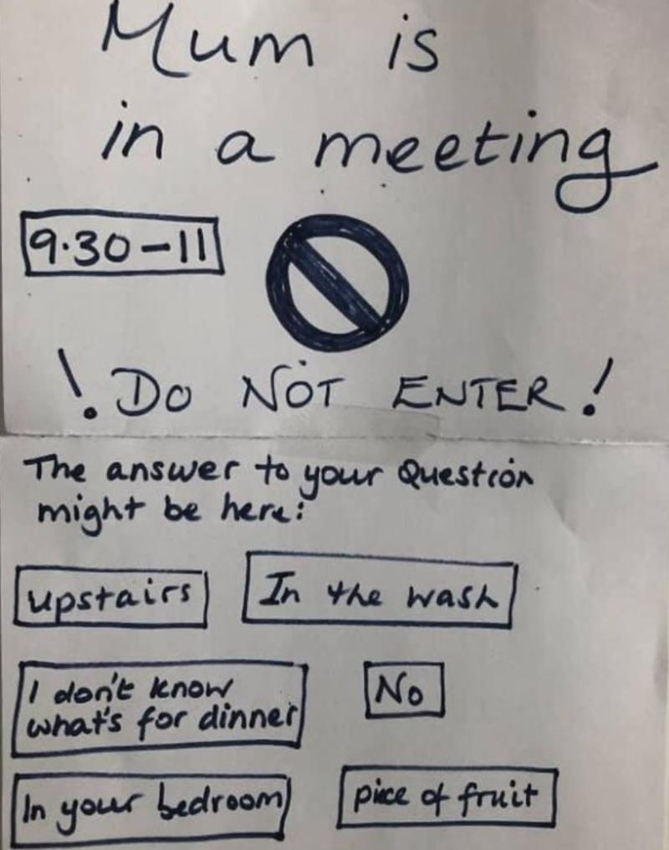

Slide 10
Choose a Great Background

Slide 11
Networking Tips for Introverts
Appreciate your power!:
“Listeners” are better networkers than talkers
2 Ears, 1 Mouth… use them in that ratio, Mark Twain
Go with a specific goal:
“Meet 3 people” (2 you know and 1 new person)
Ask scripted questions:
“Where are you from?”
“Are you a member of the group?”
Ask a “question on an answer”
Develop customized elevator pitches
Creative tips:
Sit with people you know
Invite a guest (sales prospects, reward staff)
Bring an “extrovert” to meet others and introduce you

Slide 12
Long Term: Stand Out In the Crowd
Be the Best at Something:
Promote yourself as a “subject matter expert”
Earn degrees, certificates, industry licenses
Get Connected:
Build a database (LinkedIn, Constant Contact, Mail Chimp)
Help others solve their problems, realize their passion
Get published and/or be a Speaker:
Write articles, write a book, etc., get quoted
Create a “biography” and list of topics you speak about…
Join Toastmasters, www.district23.org
Speak at industry groups
Be Recognized:
Win an award (40 Under Forty, Top CEO, Best Places to Work)
Nominate others…
Notes:
12

Slide 13
When You’re Hosting an Online Meeting
Develop a Meeting Plan:
Define the purpose of the meeting
Choose a date and time (MST)
Choose an online platform (ZOOM, WebEx, etc.)
Encourage networking via breakout rooms
Promote your Event:
Write a press release
Create a flier to post on bulletin boards at cafes, kiosks around town, etc.
Post on select local calendars:
Print/Online (250+ statewide), BizCalendar, SPINGO, YourPost, Etc.
Send announcement to targeted orgs to announce to their members
Assess Your Results:
Follow-up with an Attendee Survey/Questionnaire
Ask how they heard about your event, other topics they suggest, etc.
Notes:
13

Slide 14
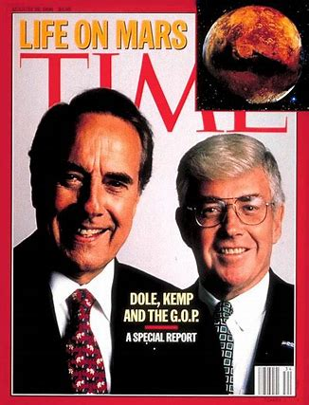
“Give it Back Better Than You Got it”
Jack F. Kemp
1935-2009
US Presidential and Vice-Presidential Candidate
US HUD Secretary
US House of Representatives (NY, 1971-1989
Quarterback, NFL and AFL Teams
Notes:
14

